Slide 1

Performance and Power Characterization of Cellular Networks and Mobile Application Optimizations
Junxian Huang
University of Michigan
April 25, 2013

Slide 2



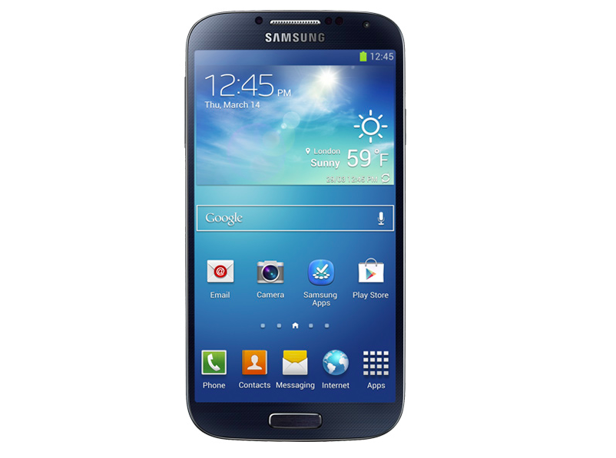





Smartphone Ecosystem
Slow!
Out of battery!
Customer
Smartphone
Vendors
Application
Developers
Mobile
Carriers
Content
Providers

Slide 3
Key Motivations
Performance and power characteristics of cellular networks and smartphone applications are not well studied
especially for the new LTE networks
Many smartphone applications are not well designed with inefficient use of network, radio and power resources
mainly due to the unawareness of the cellular specific characteristics

Slide 4
My Research Goal
To design practical and effective methods to characterize the resource utilization (bandwidth, energy, radio resource…) in cellular networks and improve the mobile application design.
Challenges
Multiple entities involved
The solution needs to be general and practically deployable
Requires evaluation using real cellular workload

Slide 5
Thesis Statement
We devise a suite of systematic methodology and tools to accurately measure the performance and power characteristics of cellular networks (both 3G and the LTE 4G networks) as well as the mobile applications, and to optimize the mobile application design based on such knowledge

Slide 6
Roadmap
MobiPerf: characterizing cellular network performance
Anatomizing smartphone application performance
An In-depth Study of LTE
Characterizing Radio Energy Usage
RadioProphet: Optimizing Smartphone Energy and Radio Resource

Slide 7
Roadmap
MobiPerf: characterizing cellular network performance
Anatomizing smartphone application performance
An In-depth Study of LTE
Characterizing Radio Energy Usage
RadioProphet: Optimizing Smartphone Energy and Radio Resource

Slide 8

Design Goals of MobiPerf
Measure most relevant network characteristics of cellular networks
Measurement results not be affected by any external factors
Attract a large number of users covering different carriers and geographical regions
Benefit the research community in terms of both tool and data

Slide 9
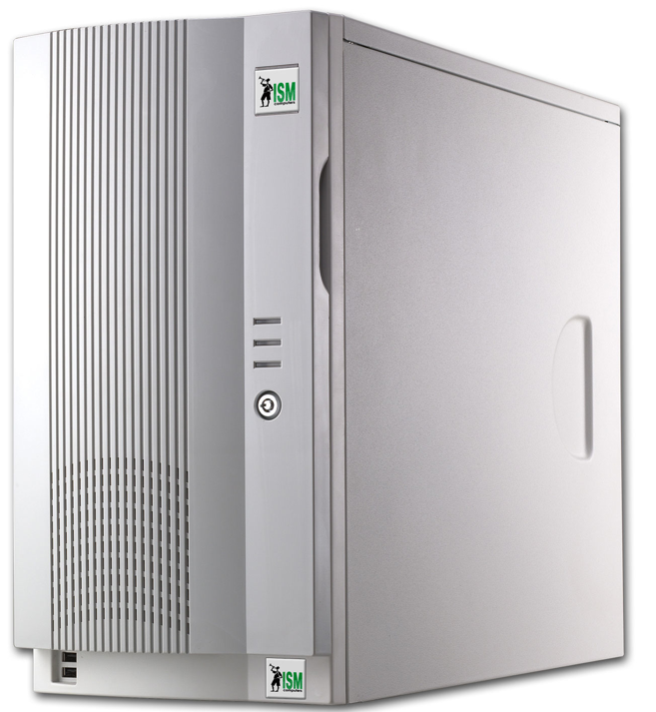
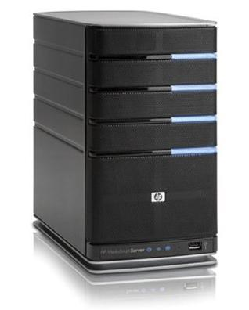
Cellular Network Metrics
DNS (domain resolution)
Local DNS response time
TCP
Common TCP metrics: downlink/uplink throughput, round-trip time (RTT), packet loss rate, etc.
For TCP throughput test, we choose the closest nodes among the 120+ global M-Lab nodes and use parallel TCP connections
Local DNS server
Smartphone
Web server

Slide 10

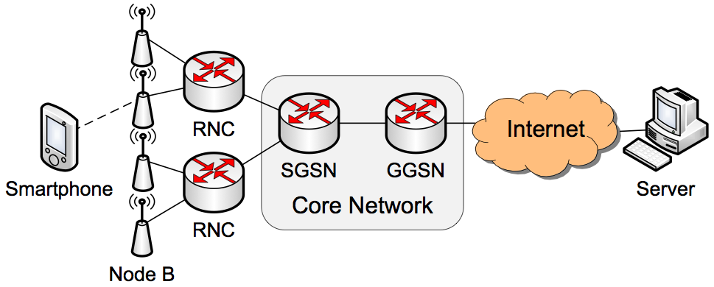
Cellular Network Metrics
Ping (Impact of diverse Internet servers)
Ping A: Ping latency to the first responsive IP hop
Ping B: Ping latency to landmark servers at diverse Internet locations
Ping A
Ping B

Slide 11
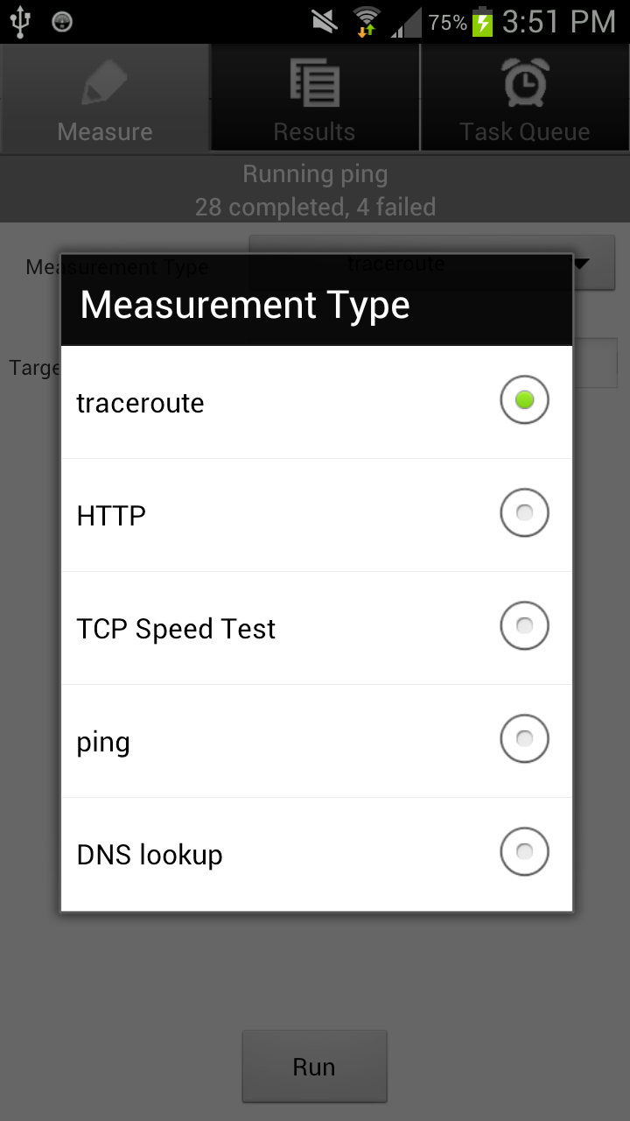

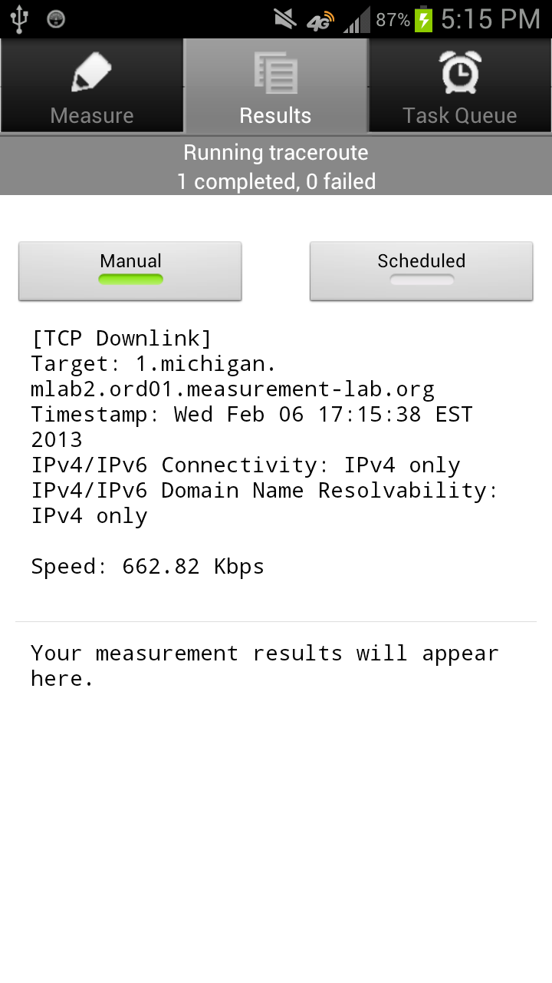
http://mobiperf.com

Slide 12
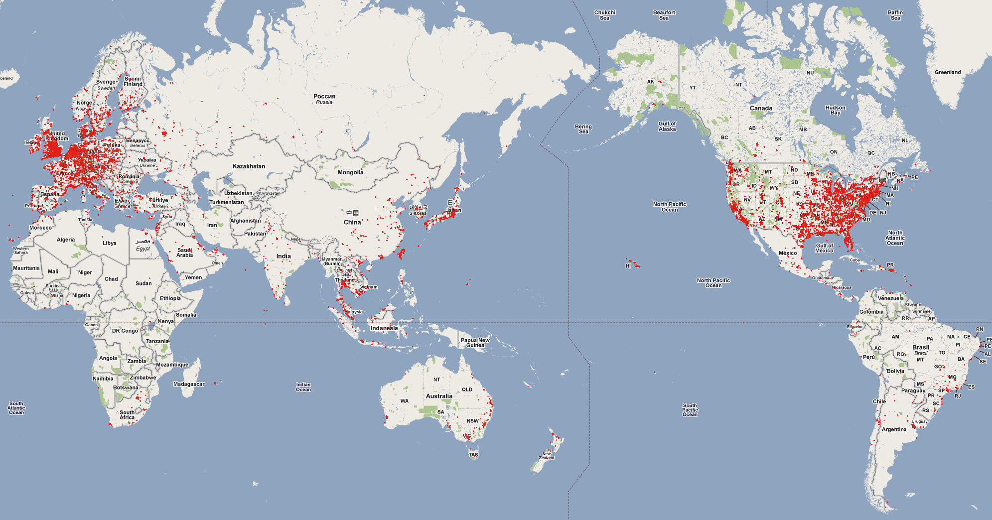
Coverage of MobiPerf Data
70K+ users 200K+ runs 84 carriers 147 countries

Slide 13
MobiPerf Benefits the Research Community
Open source
https://github.com/Mobiperf/MobiPerf
Other researchers can easily add modular measurement tasks into MobiPerf tool
Open data
gs://openmobiledata_public (Google storage)
Recognition
In 2011, People's Choice Award and Open Internet App Reward in the FCC Open Internet Apps Challenge

Slide 14
Roadmap
MobiPerf: characterizing cellular network performance
Anatomizing smartphone application performance
An In-depth Study of LTE
Characterizing Radio Energy Usage
RadioProphet: Optimizing Smartphone Energy and Radio Resource

Slide 15
Smartphone web browsing is complicated
DNS lookup
Content customization
1
Client configuration
Server configuration
Local DNS server
HTML rendering & JavaScript execution
Server processing delay
5
3
Network condition
2
4
TCP handshake
TCP data transfer
Smartphone
Web server

Slide 16
Key challenges of web performance analysis
Multiple factors have joint impact
Network condition
Client settings
Server configurations
Content differences
Lack of low-level information and access
No visibility into link layer
Difficult to instrument client OS and application

Slide 17
How to isolate impact of individual factor?
Vary one factor at a time
Network condition
Simulate cellular network with WiFi via iptables
Client settings
Control TCP concurrency
Server configurations
Change compression mode and server parallelism
Content difference
Host static website snapshots locally

Slide 18
How to identify performance bottlenecks?
TCP flow analysis technique to break down page loading time
DNS lookup time
TCP handshake time
TCP idle time
TCP transfer time
T₁
index.html
logo.png
t_{a}
t_{b}
T₂
Time
T

Slide 19
Web browsing breakdown
Web browsing performance bottlenecks
Client execution (TCP idle time)
Network transfer (TCP transfer time)
TCP transfer time
TCP idle time
Page loading time (seconds)

Slide 20
Lessons from web browsing performance study
Performance bottlenecks of web browsing
Client execution
Data download (less critical for LTE)
Higher concurrency and content compression significantly improves performance
Content customization is beneficial
Data URL scheme
Minification
Redirection reduction

Slide 21
Roadmap
MobiPerf: characterizing cellular network performance
Anatomizing smartphone application performance
An In-depth Study of LTE
Characterizing Radio Energy Usage
RadioProphet: Optimizing Smartphone Energy and Radio Resource

Slide 22

LTE is New, Requires Exploration
4G LTE (Long Term Evolution) is future trend
Initiated by 3GPP in 2004
100Mbps DL, 50Mbps UL, <5ms latency
Entered commercial markets in 2009 and now available in more than 10 countries

Slide 23
Motivations
LTE has not been extensively studied empirically in a commercial network setting
Study how network resources are utilized across different protocol layers for real users
Evaluate the benefits of increased bandwidth for mobile applications and essential network protocols to identify their limitations

Slide 24
LTE network topology of the studied carrier

Slide 25
LTE network topology of the studied carrier
Data collection point

Slide 26
Data set studied
Data set statistics
Covering a fixed set of 22 eNBs at a large metropolitan area in the U.S.
Over 300,000 users
3.8 billion packets, corresponding to 3 TB of LTE traffic
Collected over 10 consecutive days
Data contents: packet header trace consisting of
IP and transport-layer headers
A 64-bit timestamp for each packet
No payload data is captured except for headers of HTTP

Slide 27
Queueing delay
Large buffers in the LTE networks may cause high queuing delays
Bytes in flight – unacknowledged TCP bytes

Slide 28
High queueing delay causes unexpected TCP behavior
When one LTE user is downloading data …
Each dot corresponds to either a data packet or an ACK packet

Slide 29
High queueing delay causes unexpected TCP behavior
bytes in flight growing

Slide 30
High queueing delay causes unexpected TCP behavior
Packet loss

Slide 31
High queueing delay causes unexpected TCP behavior
Fast retransmission allows TCP to directly send the lost segment
to the receiver possibly preventing retransmission timeout
Fast retransmission

Slide 32
High queueing delay causes unexpected TCP behavior
TCP uses RTT estimate to update retransmission timeout (RTO)
However, TCP does not update RTO based on duplicate ACKs
RTT: 262ms
RTO: 290ms
Duplicate ACKs

Slide 33
High queueing delay causes unexpected TCP behavior
Retransmission timeout happens, the congestion window drops to 1 segment, triggering slow start, hurting TCP performance
RTT: 356ms
RTO: 290ms
RTT > RTO, timeout!
Slow start

Slide 34
Prevalence of the slow-start problem
For all the large TCP flows with ≥ 1 packet loss, 20% of them suffer from the slow start problem, which consists of 12.3 % of all large TCP flows
In one case, a 3-minute flow even experience 50 slow starts, resulting in an average throughput of only 2.8Mbps, while the estimated bandwidth actually larger than 10Mbps

Slide 35
Passive bandwidth estimation algorithm based on server-side traces
Import for understanding the network utilization efficiency of mobile applications
Active probing methods do not apply since the network condition is highly variable and it is impossible to launch measurement for all users

Slide 36
Bandwidth estimation algorithm
Typical TCP data transfer

Slide 37
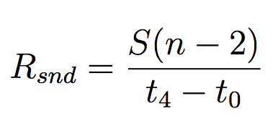
Bandwidth estimation algorithm
Assume packet size is S,
sending rate between
t₀ and t₄ is

Slide 38
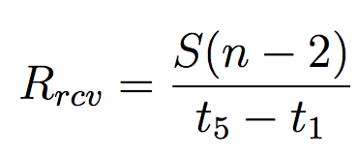
Bandwidth estimation algorithm
From UE’s perspective,
the receiving rate for
these n − 2 packets is

Slide 39
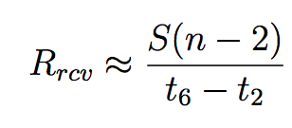
Bandwidth estimation algorithm
Typically, t₂ is very close
to t₁ and similarly for
t₅ and t₆

Slide 40
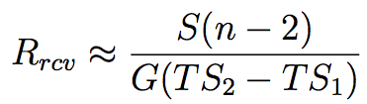
Bandwidth estimation algorithm
We use TCP Timestamps
option to calculate
t₆ − t₂ (G is a constant
that can be inferred for
each client)
93% of the TCP flows have TCP Timestamps option enabled

Slide 41
Bandwidth estimation algorithm
Using a sliding window, we obtain pairs of (R_{snd} , R_{rcv} )
If a list of conditions about R_{snd} and TCP flow characteristics are met, R_{rcv} is the estimated bandwidth
We use local controlled experiments to validate, the error rate is < 8%
Using this algorithm, we are able to estimate the available bandwidth for over 90% of the large downlink flows

Slide 42
Bandwidth utilization by real applications in LTE
Median of bandwidth utilization ratio is 20%, and on average, the utilization ratio is 35%
For 71% of the large flows, the bandwidth utilization ratio is below 50%
Reasons for underutilization
Small object size
Insufficient receiver buffer
Inefficient TCP behaviors

Slide 43
Bandwidth estimation timeline for two sample large TCP flows
LTE network has highly varying available bandwidth

Slide 44
LTE bandwidth variability, RTT and TCP performance
Under small RTTs, TCP can utilize over 95% of the varying available bandwidth
When RTT exceeds 400∼600ms, the utilization ratio drops to below 50%
For the same RTT, higher variation leads to lower utilization
Long RTTs can degrade TCP performance in the LTE networks

Slide 45
Roadmap
MobiPerf: characterizing cellular network performance
Anatomizing smartphone application performance
An In-depth Study of LTE
Characterizing Radio Energy Usage
RadioProphet: Optimizing Smartphone Energy and Radio Resource

Slide 46
Radio Resource Control (RRC) state transitions in LTE

Slide 47
RRC state transitions in LTE
RRC_IDLE
No radio resource allocated
Low power state: 11.36mW average power

Slide 48
RRC state transitions in LTE
RRC_CONNECTED
Radio resource allocated
Power state is a function of data rate:
1060mW is the base power consumption
Up to 3300mW transmitting at full speed

Slide 49
RRC state transitions in LTE
Continuous Reception
Send/receive a packet
Promote to RRC_CONNECTED
Reset Ttail

Slide 50
RRC state transitions in LTE
DRX
Ttail expires
Ttail stops
Demote to RRC_IDLE

Slide 51
Power trace of RRC state transitions
The data points are sampled and DRX in RRC_CONNECTED tail
is not obvious due to the low sampling rate

Slide 52
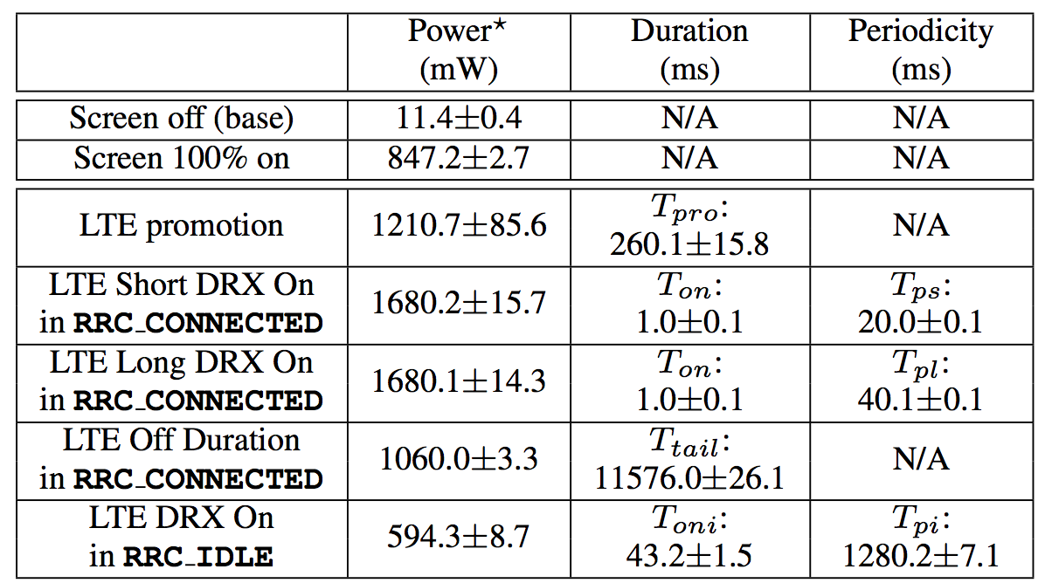
LTE power model (Verizon)
Measured with a LTE phone and Monsoon power meter, averaged with repeated samples

Slide 53



Trace-driven modeling methodology
Real packet
traces collected
on smartphones
Adjusted packet timing and time series of RRC states
Network model
simulator
Calculated radio energy usage
Power model
simulator

Slide 54

Power model validation
< 6% error rate in evaluations with real applications
Power meter
directly measure
Real applications
running
Packet traces +
Trace-driven analysis

Slide 55
UMICH data set
20 voluntary smartphone users for seven months
Undergraduate and graduate students from 8 departments at University of Michigan
Data collected (152GB in total)
Full tcpdump packet traces
Process name for sending/receiving each packet

Slide 56
Energy consumption break down
Tail energy dominates LTE energy consumption, similar to 3G
The total energy for different networks and users is normalized to be 100%

Slide 57
Energy consumption break down
Tail energy dominates LTE energy consumption, similar to 3G
The total energy for different networks and users is normalized to be 100%
The tail problem is the key factor for LTE’s high energy consumption, similar to 3G networks

Slide 58
Roadmap
MobiPerf: characterizing cellular network performance
Anatomizing smartphone application performance
An In-depth Study of LTE
Characterizing Radio Energy Usage
RadioProphet: Optimizing Smartphone Energy and Radio Resource

Slide 59
Radio Resource Control (RRC) State Machine
Data transfer
Tail timer
expires
Tail timer
starts
A packet to
transfer
Power
Tail
Time
Promotion

Slide 60
Fast Dormancy (FD)
Fast dormancy reduces the tail length by actively notifying the network for early demotion
Fast dormancy
tail timer
Default tail timer
Fast dormancy
Power
Time
60

Slide 61
Problem with the Naïve Fast Dormancy
Extra promotion overhead
UE energy and delay overhead
Signaling overhead
32 radio messages exchanged between UE and cell tower for promotion
No FD
Power
FD
Time

Slide 62
RadioProphet: Intelligently Invoke FD
RadioProphet
No FD
Power
FD
Time

Slide 63
Definition of a “burst”
A burst is a sequence of packets with inter-packet time ≤ BT, and leading/trailing gap > BT
BT is burst threshold selected empirically based on network RTTs, e.g. BT = 2s
≤ BT
≤ BT
> BT
…
> BT
Burst
Inter-burst time (IBT)

Slide 64
RadioProphet: Intelligent Radio Resource Deallocation for Cellular Networks

Slide 65
Inter-Burst Time (IBT) Prediction
Traffic features
Packet direction, port, packet length, protocol, TCP flags, application ID
Machine learning algorithms
Naïve Bayes
Regression tree
Classification tree
Ensemble boost
… etc.

Slide 66
Example Feature Selection – TCP Flags

Slide 67
Implementation and Evaluation
Data collector
Modified tcpdump cross-compiled for Android
Collect traffic for prediction
< 2% CPU overhead (energy overhead < 1% tail energy)
IBT prediction framework
Weka machine learning library ported to Android
Average model training time 200ms, prediction time 0.1ms (energy overhead < 1% tail energy)
Best accuracy for all users in the UMICH data set is 86%
Overall performance
Energy saving: 59% of radio energy (20% ~ 30% total energy)
Signaling overhead reduction: 57% comparing with default FD

Slide 68
Summary and Future Agenda
Optimizing cellular network and power resource usage for mobile applications is important and requires further study
MobiPerf
A more general mobile measurement platform to better benefit the research community in both the tool and data
Longitudinal study of the evolution of cellular networks
RadioProphet
To consider more TCP- and application-layer context to improve prediction accuracy
Public deployment and OS integration

Slide 69

Thank you!

Slide 70


